Slide 1



Box2D with Javascript
&
Brown bag series
“A practical introduction to 2d physics”
Eden House, London. 21st May 2014

Slide 2

Agenda
Download the template
What is Box2D?
Showcase some examples
A little bit of coding…
Useful links

Slide 3

Download the template
http://github.com/gazpachu/box2d.git
http://github.com/gazpachu/box2d/archive/master.zip
It includes this presentation and the step-by-step tutorial

Slide 4
What is Box2D
dynamic
World
editor
static
Gravity
vector
Bodies
Collisions
?
awake
density
sleeping
Fixtures
Shapes
friction
Velocity
Impulse
Inertia
sensor
restitution
debug draw
Force
Joints
bullet
Torque
Damping
Mass

Slide 5

- Good option to work with collisions
- Used by a lot of games, apps and artistic demos
- Very useful if you need to implement velocity,
impulse, gravity, torque, mass, inertia, etc
- Cross-browser & cross-platform
- It’s also available in Java, C++ & other languages
- Full list of features: http://box2d.org/features.html

Slide 6
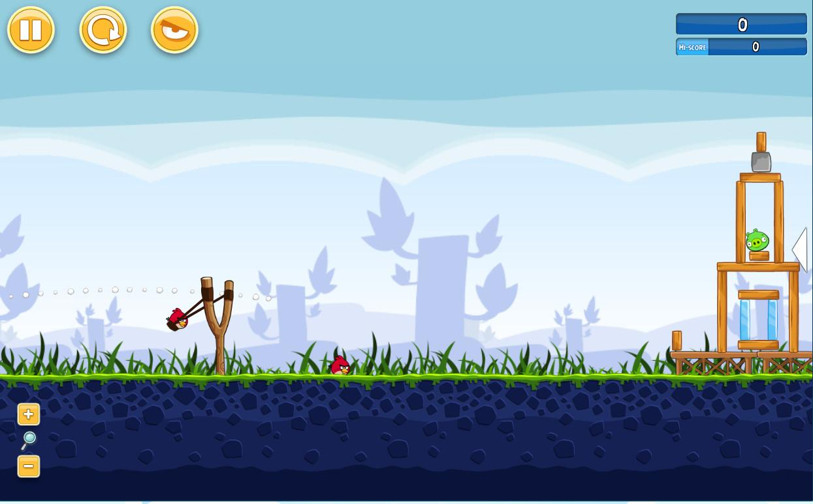
Angry Birds for Chrome (made with PlayN and a GWT port of Box2d)
http://chrome.angrybirds.com

Slide 7

ICA Art Rules (made with RoR and Box2d by SapientNitro)
http://artrules.ica.org.uk

Slide 8
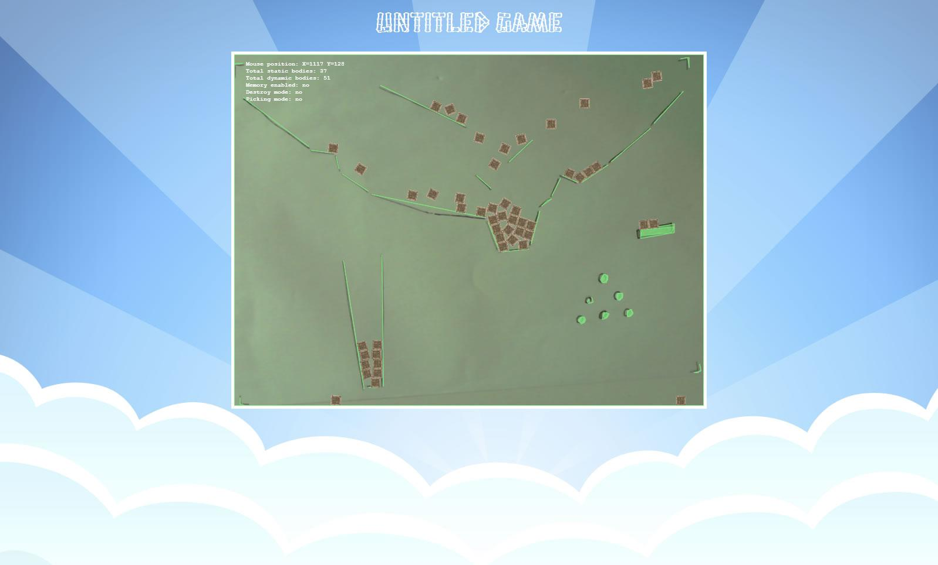
Real time shape recognition demos (box2d and openCV)
http://github.com/html5rocks/www.html5rocks.com/issues/357

Slide 9

Coding time...
open the “box2d” folder in
your favourite text editor...
var b2Vec2 = Box2D.Common.Math.b2Vec2;
var b2AABB = Box2D.Collision.b2AABB;
var b2BodyDef = Box2D.Dynamics.b2BodyDef;
var b2Body = Box2D.Dynamics.b2Body;
var b2FixtureDef = Box2D.Dynamics.b2FixtureDef;
var b2Fixture = Box2D.Dynamics.b2Fixture;
var b2World = Box2D.Dynamics.b2World;
var b2PolygonShape = Box2D.Collision.Shapes.b2PolygonShape;
var b2DebugDraw = Box2D.Dynamics.b2DebugDraw;

Slide 10
Box2D Library & Docs
Box2D Tutorials
Attaching images
https://code.google.com/p/box2dweb/
http://www.emanueleferonato.com/category/box2d
http://codingowl.com/readblog.php?blogid=134

Slide 11

Thanks ;-)

